Slide 1



Addition and Subtraction
(Signed Magnitude and Signed 2’s Complement) Session No.: 20 Course Name: Computer Organization & Architecture Course Code: R1UC305T Instructor Name: Vimal Singh

Slide 2
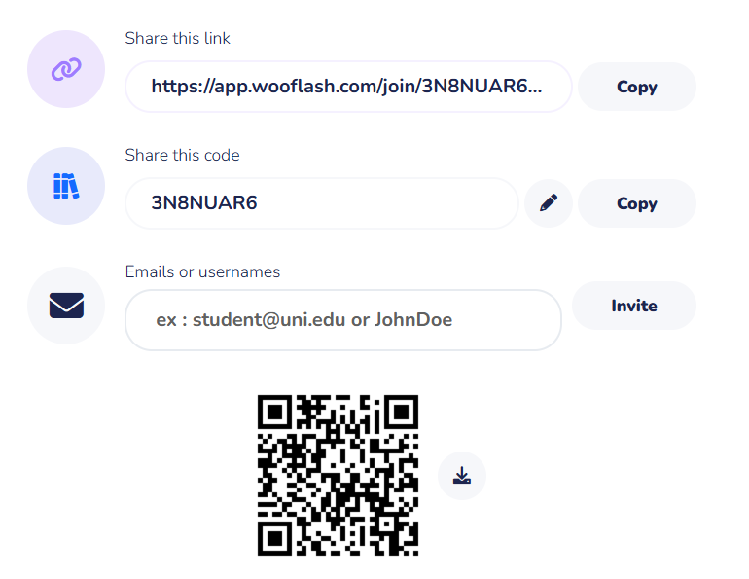
Pre Course Assesment

Slide 3
Recap:
Addressing Modes

Slide 4
At the end of this session students will be able to
Learning Outcome 1: Perform Signed Magnitude and Signed 2’s Complement Addition
Learning Outcome 2: Perform Signed Magnitude and Signed 2’s Complement Subtraction

Slide 5
Opening Activity: Magic of Zero
Magic of –0
+0 and –0
“Are they the same or different?”

Slide 6
Opening Activity: Magic of Zero
Magic of –0
+0 and –0
“Are they the same or different?”
Conclusion: Signed Magnitude (two zeros) vs 2’s Complement (single zero).

Slide 7
Session Outline
1 Binary Number System
2 Signed Magnitude Addition
3 Signed Magnitude Subtraction
4 2’s Complement Addition
5 2’s Complement Subtraction
6 Learning Activity

Slide 8
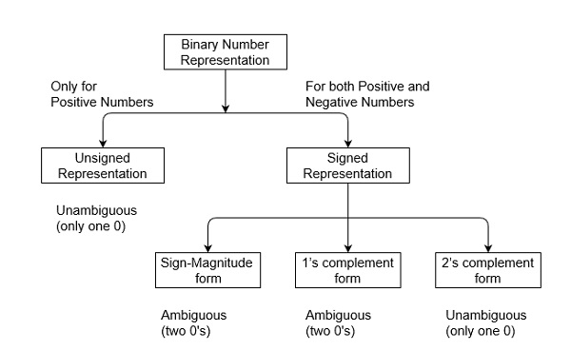
Binary Number System

Slide 9
Binary Number System:
Unsigned Representation
Unsigned numbers don’t have any sign, these can contain only magnitude of the number.
The range of unsigned binary number is from 0 to (2^n-1).
Sign-Magnitude form In this form, a binary number has a bit for a sign symbol. If this bit is set to 1, the number will be negative else the number will be positive if it is set to 0. Apart from this sign-bit, the n-1 bits represent the magnitude of the number.
The range of Sign-Magnitude form is from (2^(n-1)-1) to (2^(n-1)-1).

Slide 10
Signed Binary Number System:
1's Complement By inverting each bit of a number, we can obtain the 1's complement of a number. The negative numbers can be represented in the form of 1's complement. In this form, the binary number also has an extra bit for sign representation as a sign-magnitude form.
The range of 1’s complement form is from (2^(n-1) -1) to (2^(n-1) -1) .
2's Complement By inverting each bit of a number and adding plus 1 to its least significant bit, we can obtain the 2's complement of a number. The negative numbers can also be represented in the form of 2's complement. In this form, the binary number also has an extra bit for sign representation as a sign-magnitude form.
The range of 2’s complement form is from (2^(n-1)) to (2^(n-1) -1).

Slide 11
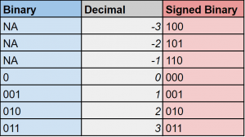
Signed Binary Number System:
Signed binary is very similar to binary, only that it includes negative numbers as well.
The sign of the binary number is determined by the MSB digit.
If MSB is a 1, then it is negative, and the magnitude value, can be found by flipping all 1’s to 0 and 0’s to 1.
If MSB is 0, then treat it like a normal binary number.

Slide 12
Addition with Signed-2's Complement Data:
Add the two numbers, including their sign bits, and discard any carry out of the sign (leftmost) bit position.
Note that negative numbers must initially be in 2's complement.
If the sum obtained after the addition is negative, it is in 2's complement form.

Slide 13
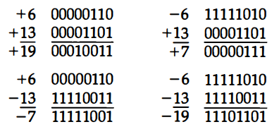
Addition with Signed-2's Complement Data:
Add the two numbers, including their sign bits, and discard any carry out of the sign (leftmost) bit position.
Note that negative numbers must initially be in 2's complement.
If the sum obtained after the addition is negative, it is in 2's complement form.

Slide 14
Subtraction with Signed-2's Complement Data:
Steps to subtract two binary numbers using 2's complement
In the first step, find the 2's complement of the subtrahend.
Add the complement number with the minuend.
If we get the carry by adding both the numbers, then we discard this carry and the result is positive else take 2's complement of the result which will be negative.

Slide 15
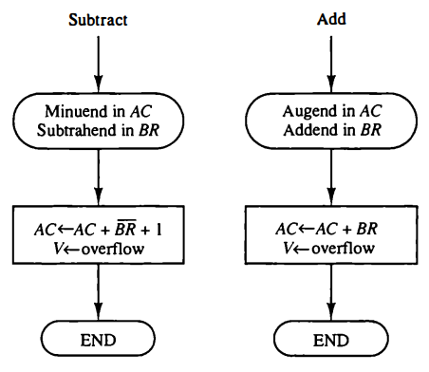
Addition and Subtraction with Signed-2's Complement Data Flowchart

Slide 16
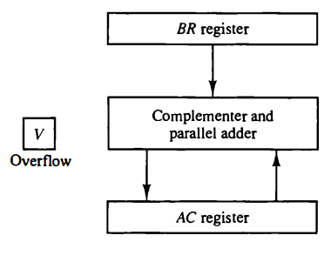
Hardware Implementation

Slide 17
Addition and Subtraction with Signed-2's Complement Data
Learning Activity 1(a): Pen and Paper Activity
Example 1: 10101 - 00111

Slide 18
Addition and Subtraction with Signed-2's Complement Data
Learning Activity 1(a): Pen and Paper Activity
Example 1: 10101 - 00111
We take 2's complement of subtrahend 00111, which is 11001. Now, sum them. So,
10101+11001 =1 01110.
In the above result, we get the carry bit 1. So we discard this carry bit and remaining is the final result and a positive number.

Slide 19
Addition and Subtraction with Signed-2's Complement Data
Learning Activity 1(b): Pen and Paper Activity
Example 2: 10101 - 10111

Slide 20
Addition and Subtraction with Signed-2's Complement Data
Learning Activity 1(b): Pen and Paper Activity
Example 2: 10101 - 10111
We take 2's complement of subtrahend 10111, which comes out 01001. Now, we add both of the numbers. So,
10101+01001 =11110.
In the above result, we didn't get the carry bit. So calculate the 2's complement of the result, i.e., 00010. It is the negative number and the final answer.

Slide 21
Signed - Magnitude Addition & Subtraction
Designate the magnitude of the two numbers by A and B.
When the signed numbers are added or subtracted, we find that there are eight different conditions to consider, depending on the sign of the numbers and the operation performed.
when two equal numbers are subtracted, the result should be +0 not -0

Slide 22
Addition & Subtraction Algorithm
When the signs of A and B are identical, add the two magnitudes and attach the sign of A to the result.
When the signs of A and B are different, compare the magnitudes and subtract the smaller number from the larger.
Choose the sign of the result to be the same as A if A > B or the complement of the sign of A if A < B.
If the two magnitudes are equal, subtract B from A and make the sign of the result positive

Slide 23
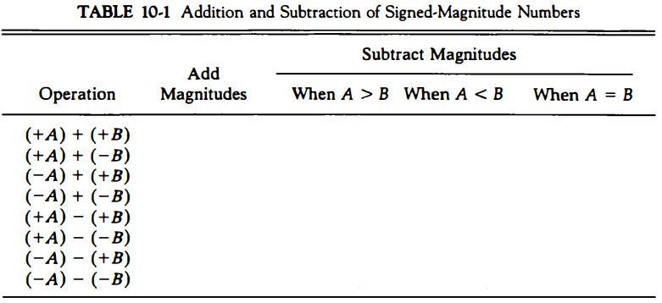
Signed - Magnitude Addition & Subtraction

Slide 24
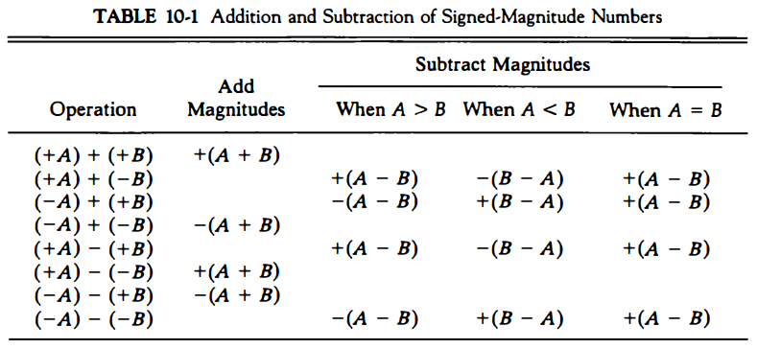
Signed - Magnitude Addition & Subtraction

Slide 25
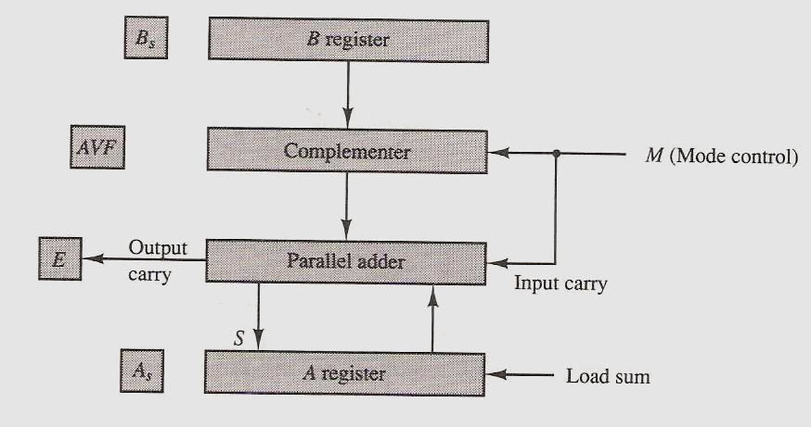
Hardware Implementation

Slide 26
Hardware Implementation
The addition of A plus B is done through the parallel adder.
The S (sum) output of the adder is applied to the input of the A register
The complementer provides an output of B or the complement of B depending on the state of the mode control M.
The M signal is also applied to the input carry of the adder.
When M = 0, the output of B is transferred to the adder, the input carry is 0, and the output of the adder is equal to the sum A + B.
When M is 1, the 1's complement of B is applied to the adder, the input carry is 1, and output S = A + B’ + 1.
This is equal to A plus the 2's complement of B, which is equivalent to the subtraction A-B.

Slide 27
Flowchart for add and subtract operations
The two signs As, and Bs,are compared by an exclusive-OR gate. If the output of the gate is O, the signs are identical; if it is 1, the sign are different.
For an add operation, identical signs indicate that the magnitudes be added.
For a subtract operation, different signs indicate that the magnitudes be added.
The magnitudes are added with a microoperation EA ← A + B. Where EA is a register that combines E and A. The carry in E: after the addition constitutes an overflow if it is equal to 1. The value of E is transferred into the add-overnow flip-flop AVF.

Slide 28
Flowchart for add and subtract operations
The two magnitudes are subtracted if the signs are different for an add operation.
The magnitudes are subtracted by adding A to the 2's complement of B.
No overflow can occur if the numbers are subtracted so AVF is cleared to 0.
E=1 indicates that A >= B and the number in A is the correct result.
If A=0, them As will 0.
E=0, indicates that A < B. For this case it is necessary to take the 2's complement of the value in A. This operation can be done with one microoperation A← A’+ 1.
The final result is found in register A and its sign in As. The value in AVF provides an overflow indication. The final value of E is immaterial.

Slide 29
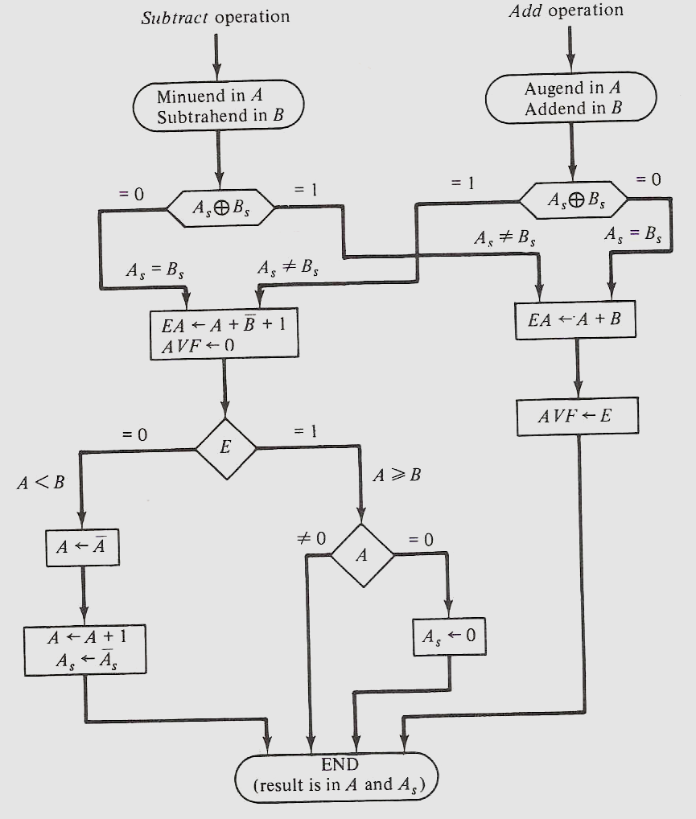

Slide 30
Summary
“Signed Magnitude is simple for humans, but 2’s Complement is efficient for machines. That’s why modern computers rely on 2’s Complement for addition and subtraction.”

Slide 31
Ensure attainment of LOs in alignment to the learning activities: outcomes (1-2)
Learning Outcome 1: Performed Signed Magnitude and Signed 2’s Complement Addition
Learning Outcome 2: Performed Signed Magnitude and Signed 2’s Complement Subtraction

Slide 32
Discussion on the post session activities
“How many zeros exist in signed magnitude?”
“Which method do computers actually use?”
“What is the 2’s complement of 1010?”

Slide 33

Review and Reflection from students

Slide 34
Thank You

